Slide 1

iPhone App Development
Lecture #4
November 8, 2011

Slide 2
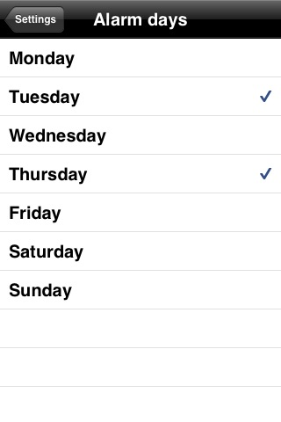
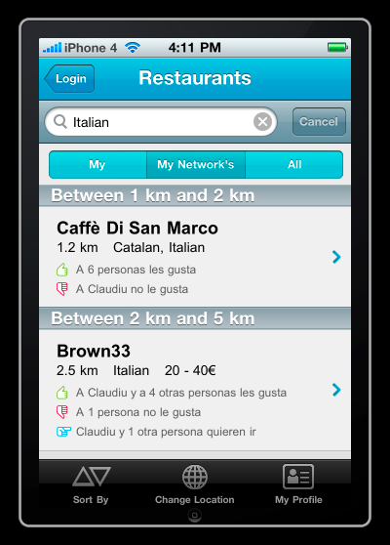
Today
UITableView
UITabBar

Slide 3
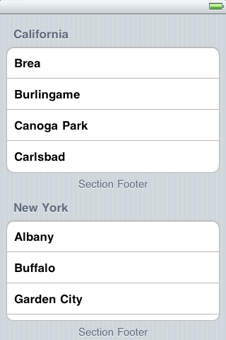
UITableView
UITableViews are used to display things in a table
It can have two styles: plain or grouped

Slide 4
UITableView
YOU MUST HAVE A TABLE VIEW DELEGATE AND DATA SOURCE TO POPULATE YOUR TABLE
Delegate
Determines what happens when a cell is selected
Data source
Has lots of important methods (that are automatically called) that let the table know how to populate itself
Note: Delegate and Data Source methods are called automatically at the appropriate time, but you still need to implement them yourselves

Slide 5
UITableView
UITableViewDelegate
As discussed before, a delegate is a “helper class” that implements a protocol
Lots of UITableViewDelegate methods exist
-(void)tableView:(UITableView *)tableView didSelectRowAtIndexPath
This method tells your app what to do when a row at a particular NSIndexPath is selected
NSIndexPath is an ordered pair (section, row)
Can access different data from the table using indexPath.section and indexPath.row

Slide 6
UITableView
UITableViewDataSource
So many important methods here
-(NSInteger)numberOfSectionsInTableView
-(NSInteger)tableView:(UITableView *)tableView numberOfRowsInSection
-(UITableViewCell *)tableView:(UITableView *)tableView cellForRowAtIndexPath:(NSIndexPath *)indexPath
This is the table view’s core. It tells the table view what the cell at a given index path should contain
Text, detail text, icons, pictures, etc.

Slide 7
UITableView
UITableViewDataSource cont.
-(NSString *)tableView:(UITableView *)tableView titleForHeaderInSection
-(BOOL)tableView:(UITableView *)tableView canEditRowAtIndexPath
-(BOOL)tableView:(UITableView *)tableView canMoveRowAtIndexPath
MUST UPDATE DATA SOURCE WHEN YOU DO THIS
Custom UITableViewCells
Can add images, custom fonts, background colors, etc.
Can do this by either subclassing UITableViewCell or specifying all of it in cellForRowAtIndexPath

Slide 8
UITabBar
Another staple in iOS
Apple says you should use this only as the root of your program
Not necessarily the best thing 100% of the time, but it’s good practice
On the iPhone, shouldn’t have more than five tabs
If you are making the tab bar in your root view controller (which we will), your app delegate should be a UITabBarControllerDelegate

Slide 9
UITabBar
Creating a UITabBar
Creation is done within the App Delegate
One of your instance variables should be a UITabBarController
Initialize view controllers and add them to an array. Once the array is complete, set your UITabBarController’s viewControllers property to the array.
Normally you want a UINavigationController in at least one of your tabs, and it’s good to have one in all of them in case you want them
Create UINavigationControllers with your view controllers as the root view controllers, add them to an array, then set your UITabBarContorller’s viewControllers property to that array

Slide 10
UITabBar
Within each view controller, set its tabBarIcon property to the icon you want
To set the caption on the tab, just set the view controller’s title property
This will set both the tab’s caption and the navigation bar’s title label to this NSString

Slide 11
Demo: Table Views and Tab Bars

